Slide 1

SUBNET classifier A document Similarity Model
Michael Ippolito
Data607
Final project

Slide 2






SUBNET CLASSIFIER A document similarity model
The Problem
?
?
?
?
Hacker
?
Pwned! :(
University

Slide 3

SUBNET CLASSIFIER A document similarity model
The Reason
Department
Division
I have a great idea! Let’s call it the “Psych VPN.”
Psychology dept
L&S
Psychiatry dept
Med School
?
Health Services
Psychiatric Svcs
New subnet
Network Svcs
Info Tech
Network team
“Psych VPN”
Psychiatry dept
UW Hospital

Slide 4


SUBNET CLASSIFIER A document similarity model
The Solution
Subnet classification model
Leadership
Network team
Cybersecurity

Slide 5
SUBNET CLASSIFIER A document similarity model
The Data
Subnet counts
Classified by IP block | 20393
Manually classified | 1027
Unclassified | 6478
Total | 27898

Slide 6
SUBNET CLASSIFIER A document similarity model
University Divisions
A01 | General Education Administration
A02 | General Services
A03 | Business Services
A04 | Division of Student Life
A05 | Enrollment Management
A06 | Division of Information Technology (DoIT)
A07 | College of Agricultural & Life Sciences (CALS)
A10 | International Division
A12 | Wisconsin School of Business
A17 | School of Education
A18 | Arts Institute
A19 | College of Engineering
A27 | School of Human Ecology
A34 | Research and Graduate Education
A37 | T&L Collaboration
A40 | Nelson Institute for Environmental Studies
A42 | Intercollegiate Athletics
A45 | Law School
A46 | Public Media
A47 | Division of Extension
A48 | College of Letters & Science (L&S)
A49 | General Library System
A52 | Wisconsin State Lab of Hygiene (WSLH)
A53 | School of Medicine and Public Health (SMPH)
A54 | School of Nursing
A56 | School of Pharmacy
A57 | University Health Services (UHS)
A63 | Officer Education
A71 | Facilities Planning & Management (FP&M)
A77 | UW Police Department
A80 | Recreational Sports
A85 | University Housing
A87 | School of Veterinary Medicine
A88 | Wisconsin Veterinary Diagnostic Lab (WVDL)
A93 | Division of Continuing Studies
A90 | Wisconsin Institute for Discovery
A96 | Wisconsin Union
net | Campus networks
uwhc | University of Wisconsin Hospitals and Clinics

Slide 7

SUBNET CLASSIFIER A document similarity model
Subnet Classification Model
1. Scrape public web sites for each university division
Corpus
2. Manually add (esoteric) tokens
3. SQL query to generate list of subnets
a. 30% validation set
b. 70% training set (5-fold cross-validation)
Training set

Slide 8
SUBNET CLASSIFIER A document similarity model
Training Strategy
Training set
Corpus
Token | Weight | Division
medicine | scraped | School of Medicine
psychiatry | scraped | School of Medicine
health | scraped | School of Medicine
mednet | manual | School of Medicine
vpn | scraped | Information Technology
voip | scraped | Information Technology
network | scraped | Information Technology
services | scraped | Information Technology
lan | manul | Information Technology
psychiatric | scraped | U. Health Services
pyschiatry | scraped | U. Health Services
services | scraped | U. Health Services
psychology | scraped | Letters & Sciences
Subnet | Description | Division
192.168.0.0/24 | Psychiatry in Building A | School of Medicine
192.168.1.0/24 | Block of VPN NATs | Information Techology
192.168.2.0/25 | UHS Psychiatric Svcs | U. Health Svcs
192.168.2.128/26 | Psychology dept L&S | Letters & Sciences
192.168.2.192/26 | Med School | School of Medicine
192.168.3.0/24 | Wireless network in psych building | [unclassified]
192.168.4.0/22 | VoIP for psych | [unclassified]
?

Slide 9
SUBNET CLASSIFIER A document similarity model
Building the Corpus
Build list of pages categorized by division
# Load list of web pages to scrape
dfcrawl <- read.csv("crawl-pages.csv", header = F)
dfcrawl <- dfcrawl %>%
rename(divcode = V1, url = V2) %>% mutate(text = '')
# Function to read pages and dump contents to data frame
crawlPage <- function(df) {
results <- GET(df$url)
dfcrawl <<- dfcrawl %>%
mutate(text = ifelse(url == df$url, results, text))
}
# Crawl pages
crawlPage(dfcrawl)
# Load manual tokens
dfmanual_tokens <- read.csv("manual-tokens.csv", header = F)
dfmanual_tokens <- dfmanual_tokens %>%
rename(word = V1, divcode = V2) %>% mutate(wt = 25)
crawlPage function
Crawl pages
Manual tokens

Slide 10
SUBNET CLASSIFIER A document similarity model
Data Tidying
Tokenize
# Tokenize
dfcorpus <- dfcrawl %>%
unnest_tokens(word, text, token = "ngrams",
n_min = 1, n = maxNgrams)
# Remove words with numbers
dfcorpus <- dfcorpus %>%
filter(!grepl('\\d', word))
# Remove all underscores
dfcorpus <- dfcorpus %>%
filter(!grepl('^_+$', word))
Remove numbers
Remove underscores

Slide 11
SUBNET CLASSIFIER A document similarity model
Stopwords
Remove stopwords,
e.g. HTML tags
# Remove stopwords
dfcorpus <- dfcorpus %>%
anti_join(custom_stopwords, by = c("word"))
# Function to remove stopwords from ngrams
removeStopwords <- function(tokens, stopwords) {
map2(tokens, lapply(tokens, function(x) {
unlist(
lapply(
strsplit(x, " "), function(y) {
any(y %in% stopwords)
}
)
)
}
), ~ .x[!.y])
}
Stopwords in ngrams

Slide 12
SUBNET CLASSIFIER A document similarity model
Term Frequencies
Filter by term frequency
# Filter infrequent and too-frequent terms
dfcorpus <- dfcorpus %>%
filter(n >= 5 & n <= 200) %>% arrange(desc(n))
# Inverse document frequency
dfidf_corpus <- dfcorpus %>%
group_by(word) %>%
summarize(idf = 1 + log((nrow(dfcrawl) + 1) / sum(n),
base = 10))
# Term frequency/inverse document frequency
dfcorpus <- dfcorpus %>%
inner_join(dfidf_corpus, by = c("word")) %>%
mutate(tfidf = idf * n)
IDF
TFIDF

Slide 13
SUBNET CLASSIFIER A document similarity model
Most Frequent Terms

Slide 14
SUBNET CLASSIFIER A document similarity model
Terms by University Division

Slide 15
SUBNET CLASSIFIER A document similarity model
Data Partitioning
Partition data
70% training
30% validation
# reserve validation set
dftrain <- dfjson %>%
filter(train == 1)
validation_prop = 0.3
validation_rows <- sample(nrow(dftrain),
size = nrow(dftrain) * validation_prop, replace = F)
dftrain <- dftrain %>%
mutate(validation_set = ifelse(
row_number() %in% validation_rows, 1, 0))
dfvalidate <- dftrain %>%
filter(validation_set == 1)
dftrain <- dftrain %>%
filter(validation_set == 0)
# Create training set, partition into [numfolds] groups
numfolds <- 5
num_rows <- sample(nrow(dftrain), replace = F)
dftrain <- dftrain[num_rows, ]
dftrain <- dftrain %>%
mutate(fold = ((row_number() - 1) %% numfolds) + 1)
Partition training set
into folds

Slide 16
SUBNET CLASSIFIER A document similarity model
Training
Training loop
# Iterate over holdout folds
for (holdoutfold in 1:numfolds) {
for (maxfeatures in maxFeaturesArray) {
# Train
dftrain_set <- dftrain %>%
filter(fold == holdoutfold)
compareDocs(
dftrain_set,
holdoutfold,
maxfeatures,
distMethod,
tstart
)
}
} # Iterate over training folds
maxFeaturesArray <-
c(10, 25, 50, 100)
distMethod <-
c('euc', 'man’,
'cos', 'jac')

Slide 17
SUBNET CLASSIFIER A document similarity model
Compare Documents
compareDocs <- function(dfset, holdoutfold, maxFeatures,
distMethod, tstart) {
buildCorpus(holdoutfold, maxFeatures)
# Tokenize this fold
...
for (row in 1:nrow(dfset)) {
dfnet <- dfnet_unpadded %>%
full_join(dftrain_corpus %>%
distinct(word), by = c("word"))
dfnet$tfidf[is.na(dfnet$tfidf)] <- 0
Build corpus
Tokenize fold
Iterate over set
Fill missing values

Slide 18
SUBNET CLASSIFIER A document similarity model
Document Term Matrix
Create DTM
# Document term matrix
dfnet_dtm <- dfnet %>%
spread(key = word, value = tfidf)
# Create matrices to do matrix arithmetic
dtmcorpus_matrix <-
dfcorpus_dtm[,2:ncol(dfcorpus_dtm)]
dtmnet_matrix <- dfnet_dtm[,4:ncol(dfnet_dtm)]
dtmnet_matrix <-
dtmnet_matrix[rep(seq_len(nrow(dtmnet_matrix)),
each = nrow(dtmcorpus_matrix)), ]
Convert to matrices

Slide 19
SUBNET CLASSIFIER A document similarity model
Distance Calcs 1
Euclidian distance
# Calculate Euclidian distance
dfresult_tmp <- (dtmnet_matrix - dtmcorpus_matrix) ^ 2 %>%
mutate(divcode = dfcorpus_dtm$divcode
dfresult_tmp <- dfresult_tmp %>%
mutate(dist_eucl = sqrt(rowSums(.[2:ncol(dfresult_tmp)])))
# Calculate cosine distance
dfresult_tmp2 <- (dtmnet_matrix * dtmcorpus_matrix) %>%
mutate(divcode = dfcorpus_dtm$divcode) %>%
dfresult_tmp2 <- dfresult_tmp2 %>%
mutate(dist_cos = rowSums(.[2:ncol(dfresult_tmp2)]))
dfresult_tmp2 <- dfresult_tmp2 %>%
mutate(dist_cos = 1 - (dist_cos /
(sqrt(sum(dtmnet_matrix ^ 2)) * sqrt(sum(dtmcorpus_matrix)))))
Cosine distance

Slide 20
SUBNET CLASSIFIER A document similarity model
Distance Calcs 2
Manhattan distance
# Calculate Manhattan distance
dfresult_tmp3 <- abs(dtmnet_matrix - dtmcorpus_matrix) %>%
mutate(divcode = dfcorpus_dtm$divcode) %>%
select(divcode, sort(colnames(.)))
dfresult_tmp3 <- dfresult_tmp3 %>%
mutate(dist_manh = rowSums(.[2:ncol(dfresult_tmp3)])) %>%
select(divcode, dist_manh)
# Calculate Jaccard distance
tmp_intersect <- dftrain_corpus %>%
group_by(divcode, word) %>%
summarize(n = n()) %>% ungroup() %>%
inner_join(select(dfnet_unpadded, word), by = c("word")) %>%
group_by(divcode) %>%
summarize(n = n()) %>% ungroup()
tmp_union <- nrow(dftrain_corpus)
dfresult_tmp4 <- tmp_intersect %>%
mutate(dist_jaccard = 1 - (n / tmp_union))
Jaccard distance

Slide 21
SUBNET CLASSIFIER A document similarity model
Model Evaluation

Slide 22
SUBNET CLASSIFIER A document similarity model
Model Evaluation

Slide 23
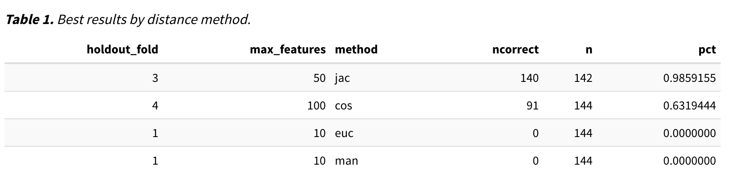
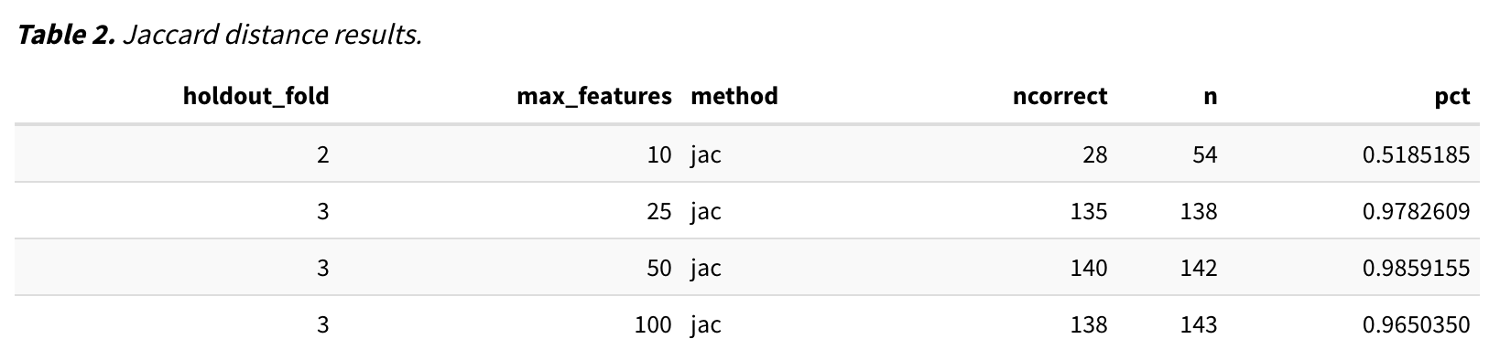
SUBNET CLASSIFIER A document similarity model
Best Model

Slide 24
SUBNET CLASSIFIER A document similarity model
Model Speed

Slide 25
SUBNET CLASSIFIER A document similarity model
Validation Set

Slide 26
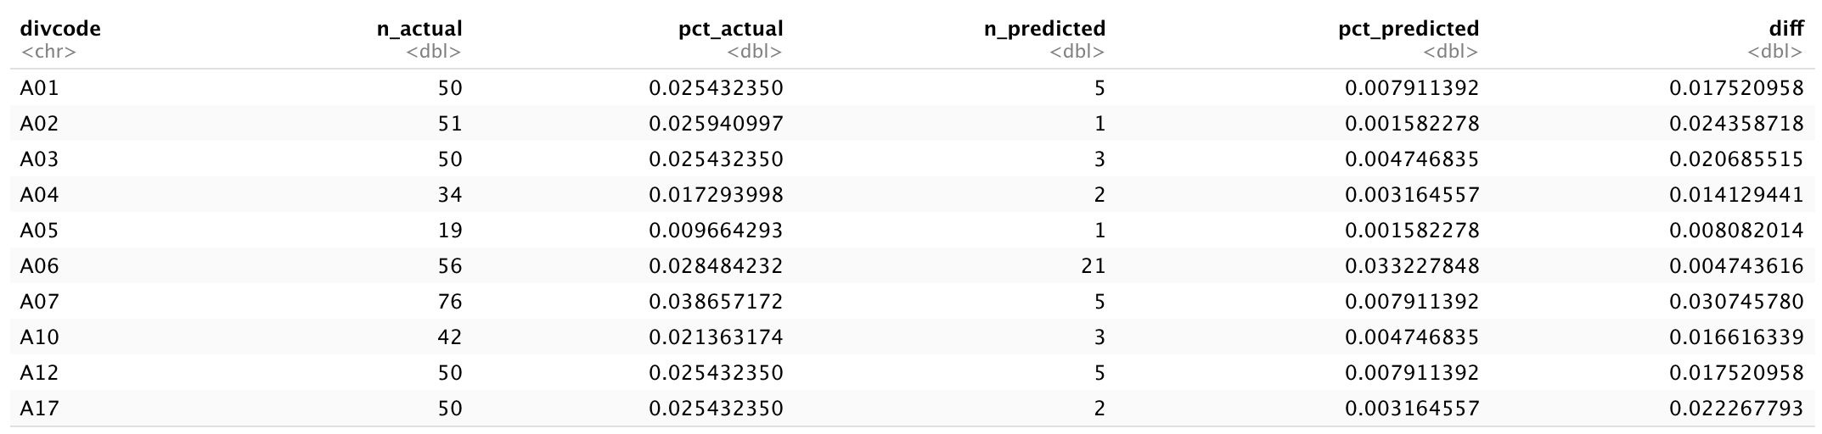
SUBNET CLASSIFIER A document similarity model
Inference for Paired Data

Slide 27
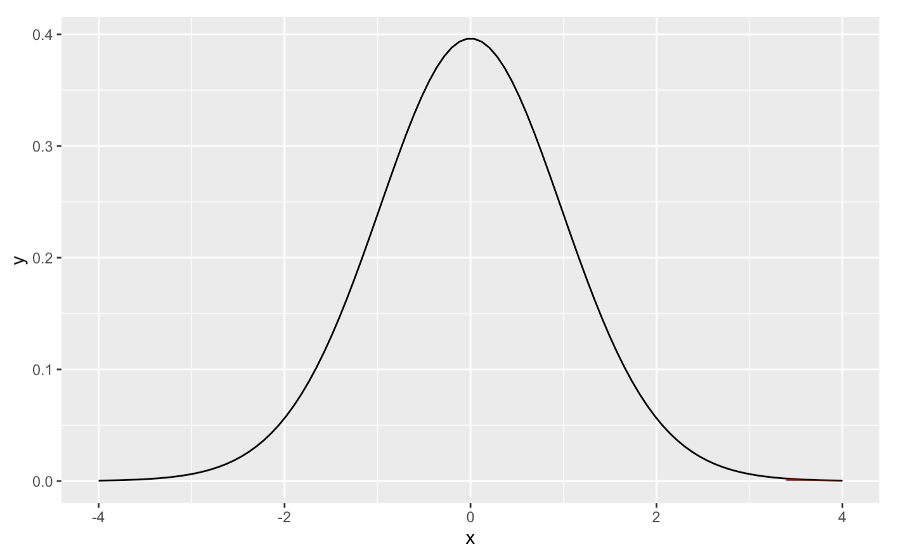
SUBNET CLASSIFIER A document similarity model
T-test
p-value = 0.000806
(< 0.05)

Slide 28
SUBNET CLASSIFIER A document similarity model
Lessons Learned
R is horrible!
Make everything a parameter
Make sure training data is accurate
Jaccard distance works the best for comparing sparse documents to dense ones
Not every problem needs a model

